Slide 1
MADHANA B
821721243032
B.TECH-ARTIFICIAL INTELLIGENCE AND DATA SCIENCE
SIR ISSAC NEWTON COLLEGE OF ENGINEERING AND TECHNOLOGY

Slide 2
IMAGE CLASSIFICATION AND RECOGNITION

Slide 3


AGENDA
Here’s a proposed agenda for focussed on image classification and recognition:
Problem statement
Project overview
Your solution and it’s value proposition
The wow in your solution project
Modelling
Results
3/21/2024 Annual Review

Slide 4

PROBLEM STATEMENT
The problem statement for image classification and recognition involves developing algorithms or models that can accurately categorize and identify objects or patterns within digital images. This typically includes tasks such as distinguishing between different types of animals, identifying handwritten digits, recognizing human faces, or detecting objects in photographs. The goal is to train a model that can generalize well to new, unseen images and accurately assign them to the correct categories or labels.

Slide 5

PROJECT OVERVIEW
Key Steps:
1.Data Collection: Gather a diverse dataset of labeled images representing different object categories or patterns.
2. Data Preprocessing: Clean and preprocess the images to ensure uniformity and enhance model performance.
3. Model Selection: Choose an appropriate deep learning architecture such as Convolutional Neural Networks (CNNs) for image recognition.
4. Model Training: Train the selected model on the preprocessed dataset using techniques like transfer learning to improve efficiency.
5. Model Evaluation: Assess the performance of the trained model using metrics like accuracy, precision, and recall.
6. Fine-tuning: Fine-tune the model and adjust hyperparameters to optimize performance further.
7. Deployment: Deploy the trained model for real-world applications, possibly integrating it into a mobile app or web service for image recognition tasks.

Slide 6

WHO ARE THE END USERS?
The end users of an image classification and recognition system include:
1.General Consumers
2. Enterprises
3. Healthcare Professionals
4. Law Enforcement and Security Agencies
5. Researchers and Academia
6. Industrial Automation
Overall, the end users can range from individual consumers to large organizations across diverse industries, all leveraging image recognition technology to enhance efficiency, productivity, and decision-making processes.

Slide 7

YOUR SOLUTION AND ITS VALUE PROPOSITION
The proposed solution for image classification and recognition offers several key value propositions:
1.Accuracy
2. Efficiency
3. Scalability
4. Adaptability
5. Integration
6. User-Friendly Interface
Overall, the solution aims to empower users across various sectors with reliable, efficient, and scalable image recognition capabilities, ultimately enhancing productivity, decision-making, and innovation in their respective domains.

Slide 8

THE WOW IN YOUR SOLUTION
The "wow" factor in our solution lies in its ability to accurately and swiftly identify objects within images with human-like precision, even in complex and diverse visual environments. By harnessing the power of cutting-edge deep learning algorithms and advanced image processing techniques, our solution goes beyond traditional methods, delivering unparalleled performance and efficiency.
3/21/2024 Annual Review
8

Slide 9
MODELLING
In the context of image classification and recognition, modeling refers to the process of designing and training a deep learning architecture, typically a Convolutional Neural Network (CNN), to learn patterns and features from input images and make predictions about their contents . Here's how the modeling process typically unfolds:
1. Architecture Selection
2.Model customization
3. Data pre-processing
4. Training
5. Validation
6. Hyper parameter Tuning
7. Model Evaluation
8. Deployment
By following these steps and leveraging state-of-the-art techniques in deep learning, the modeling phase plays a crucial role in developing highly accurate and efficient image classification and recognition systems.
9

Slide 10
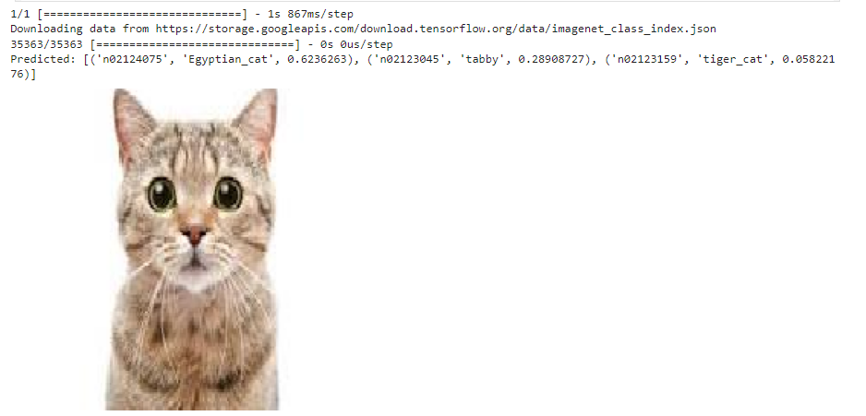
RESULTS
10

